Slide 1
Models results on hyper-spectral image and thermal image from corn field on ‘Newe Yaar’ (30.09.25_

Slide 2
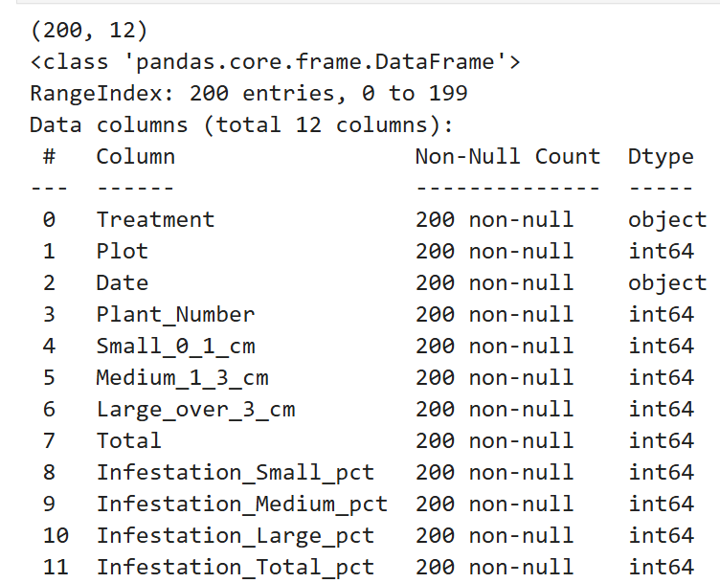
The reference dataset (The corn dataset)

Slide 3
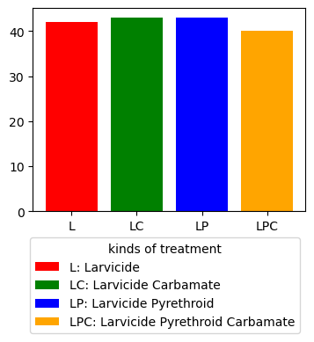
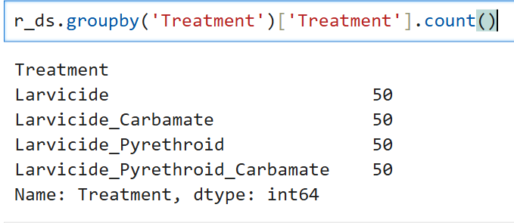
Reference dataset – correlation between treatment and amount of infestation
The conclusion from this template is there are no distinct
Difference between the kind of the treatment to the
Infestation rate.

Slide 4
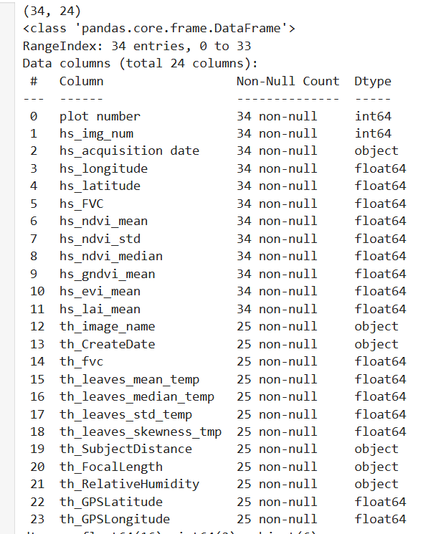
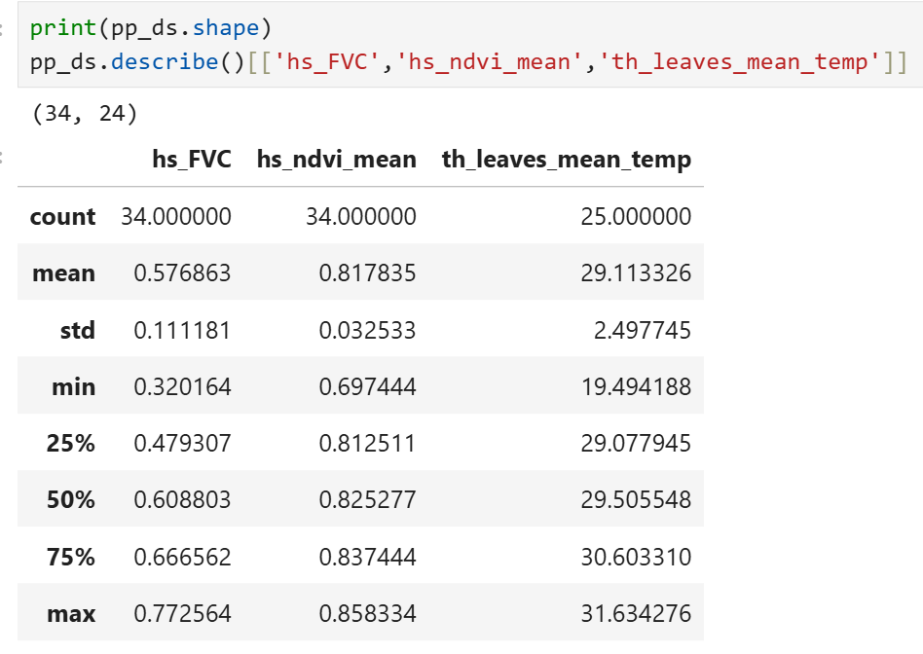
The images metrics dataset

Slide 5
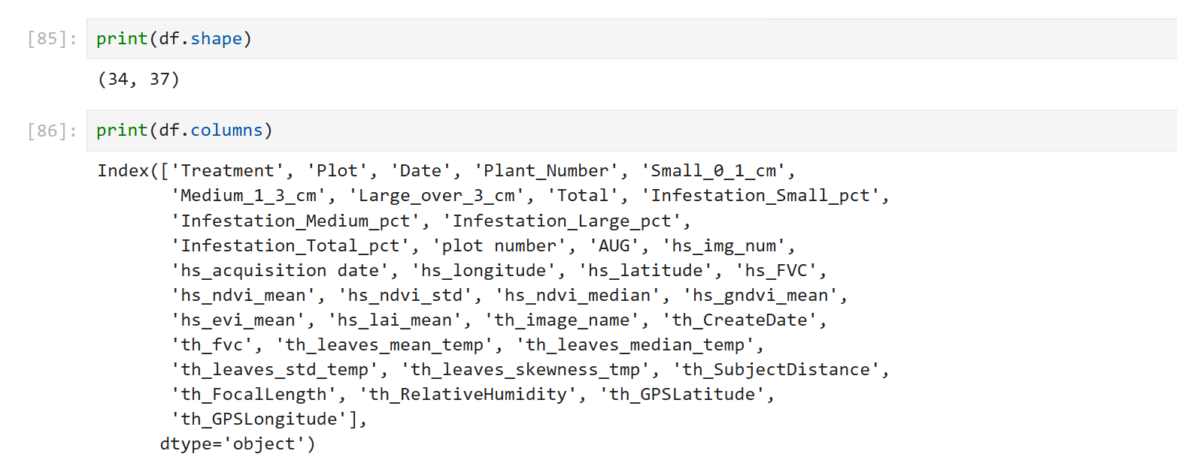
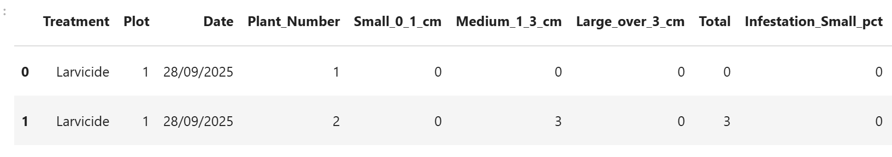
Merges datasets –option 1
We join the reference dataset and the images dataset by plot number.
the new merged dataset called : NeweYaar__20250930_full_2025-11-23 10

Slide 6
Classification –task
Binary classification of the Infestation of the leaves
not infested (0)
infested (1)
The classification task is to classify the kind of treatment by vegetation indices and thermal parameters.

Slide 7
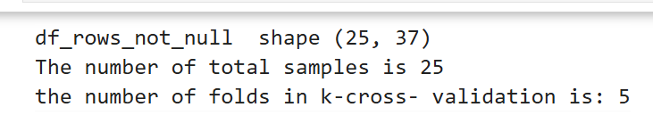
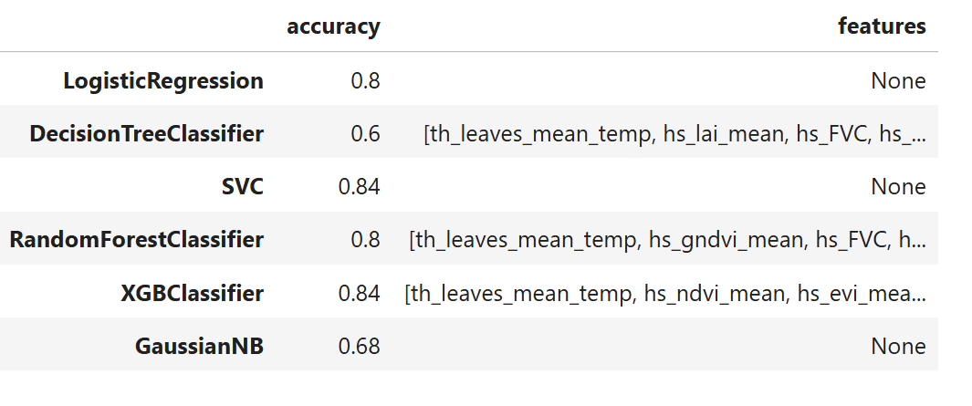
Option 1- eliminate rows that some of the parameters are null (specifically focus in rows that have both hyper-spectral and thermal images)

Slide 8
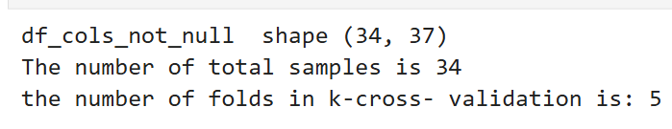
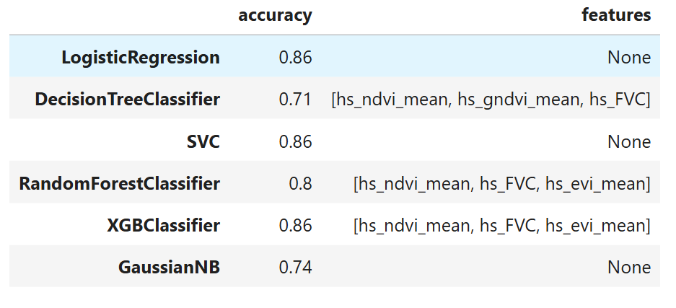
Option 2- eliminate columns that some of the parameters are null (specifically focus on hyper-spectral images)

Slide 9
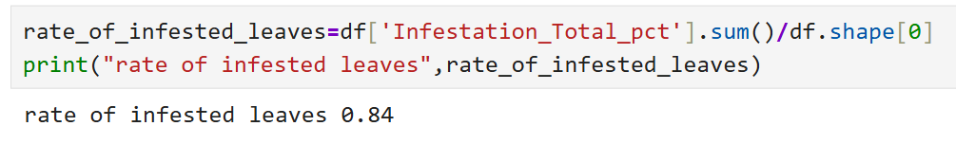
Original dataset is not balanced
Solution: augment the dataset with more negative samples by SMOTE algorithm

Slide 10
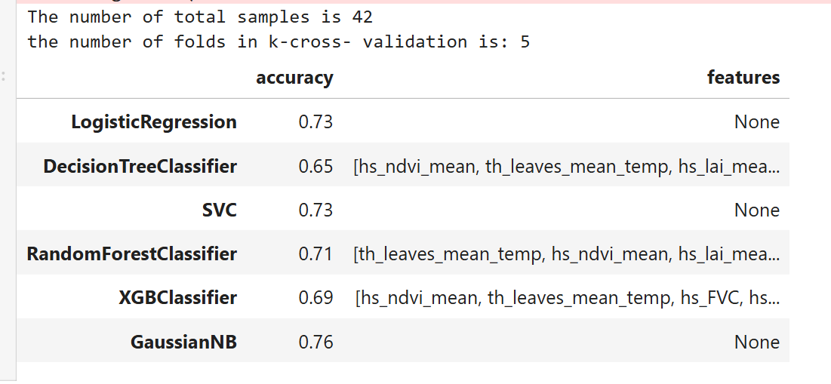
Option 1- eliminate rows that some of the parameters are null (specifically focus in rows that have both hyper-spectral and thermal images)

Slide 11
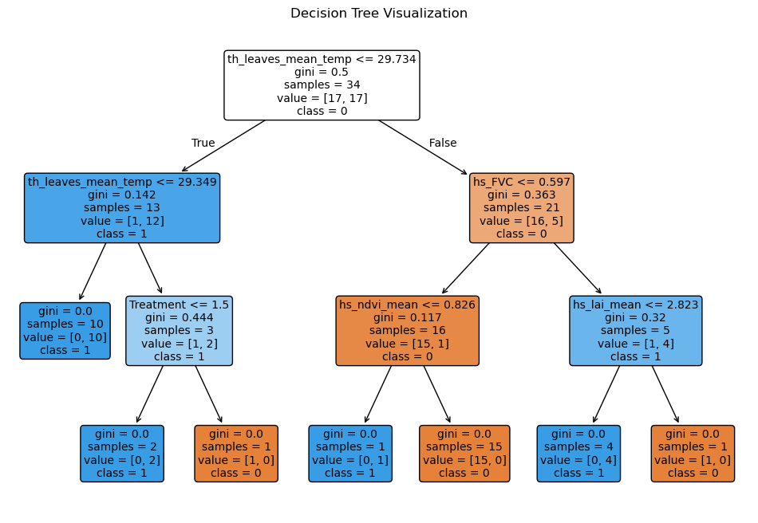
Illustration of one of the estimators

Slide 12
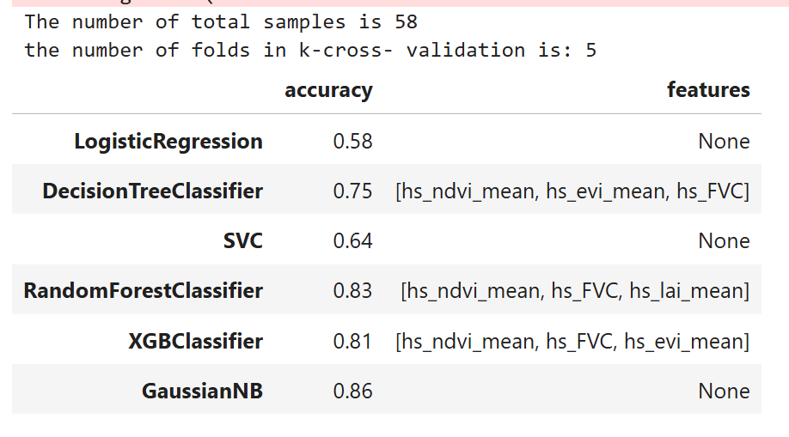
Option 2- eliminate columns that some of the parameters are null (specifically focus on hyper-spectral images)

Slide 13
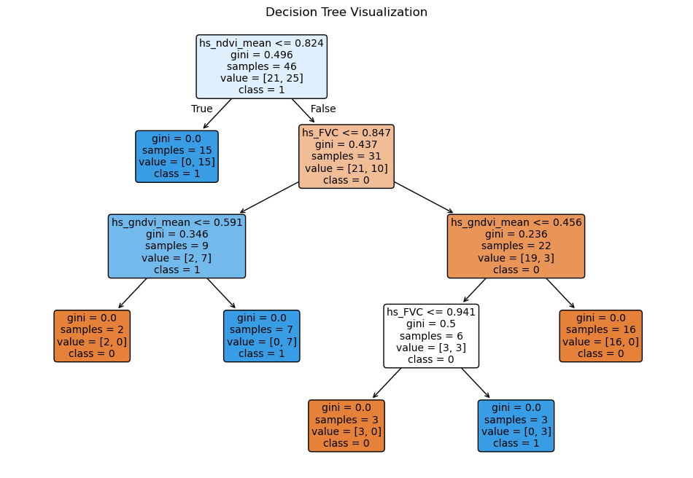
Illustration of one of the estimators

Slide 14
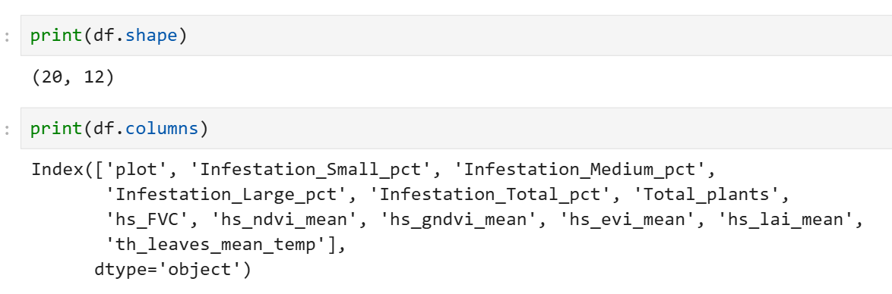
Merges datasets –option 2
The dataset below created from the merging the original reference dataset with the images-metric dataset by computing the mean of infestation_Total_pct for each plot. There 20 diffrenet plots and for each we craft 2 images (HS and Thermal) –so we average the results of two images per plot and assign it to the this plot. The dataset name is: NeweYaar__20250930_full_2025-11-20 10 16

Slide 15
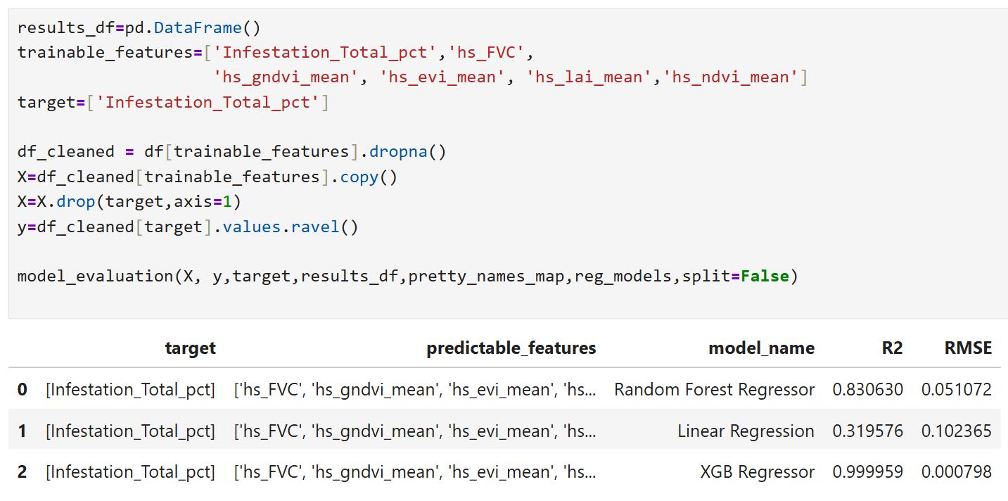
Regression task –task
The mission here is to describe the correlation between the infestation per plot and the vegetation indices.

